Slide 1
Axisymmetric project
Derek Lontine
Stuart Childs
Alex Bailey

Slide 2
Axisymmetric Quad Elements
Analytical Formulation
Computational Implementation
Verification Testing
Loading Schemes & Analytical Solutions
FEM Solutions
Error Analysis
Tests

Slide 3
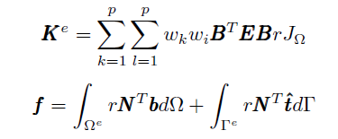
Analytical Formulation

Slide 4
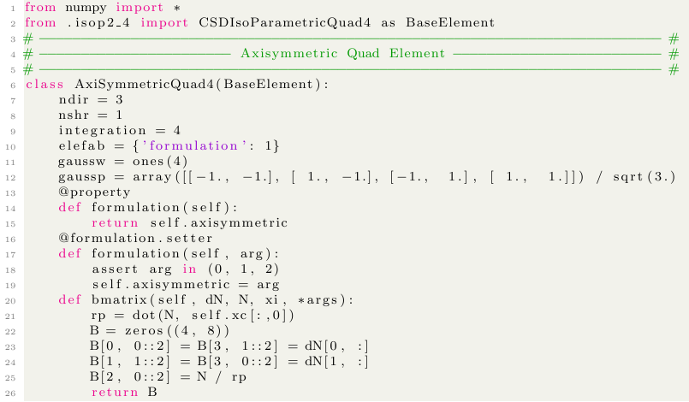
CSDAX4F: Continuum Stress-Displacement, Axisymmetric Quad 4, Full Integration

Slide 5
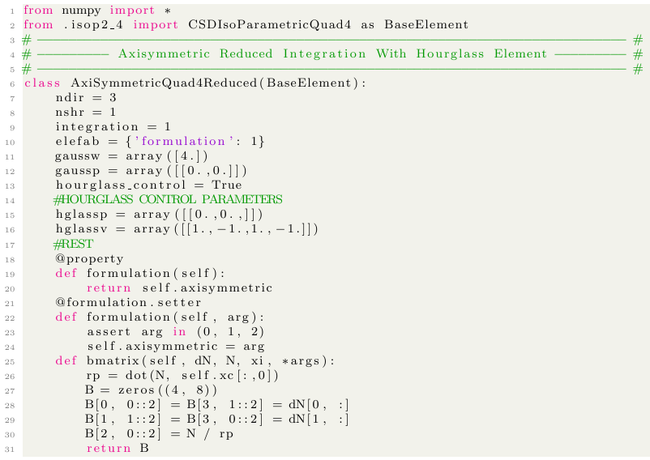
CSDAX4R: Continuum Stress-Displacement, Axisymmetric Quad 4, Reduced Integration

Slide 6
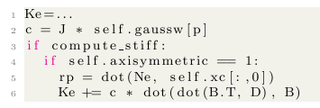
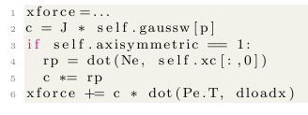
Modify the Stiffness
Fellipa Formulation
Also did similar addition of r for hourglass control, selective reduced integration functions

Slide 7
Parameters to Solve:
Element Variables:
Integration order (#of GP)
Formulation type (Santos/Fellipa)
Hourglass Control
Selective Reduced Integration Correction
Problem Parameters:
E, v
[ID], OD, thickness
Test Types:
Pinned vs fixed boundary
Concentrated vs distributed load
Plate vs washer geometry
8 total tests

Slide 8
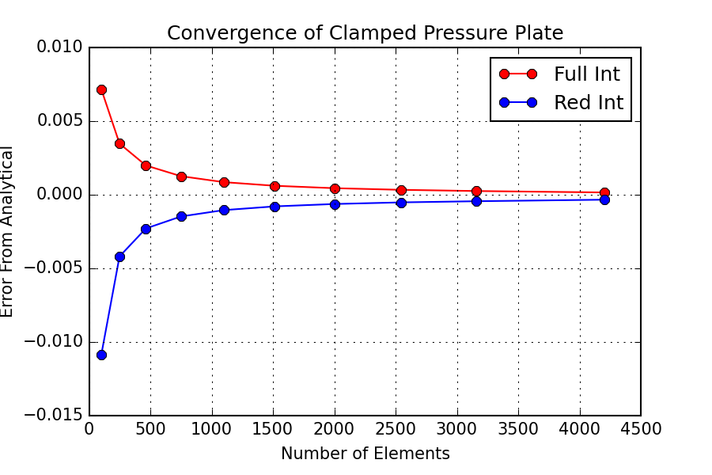
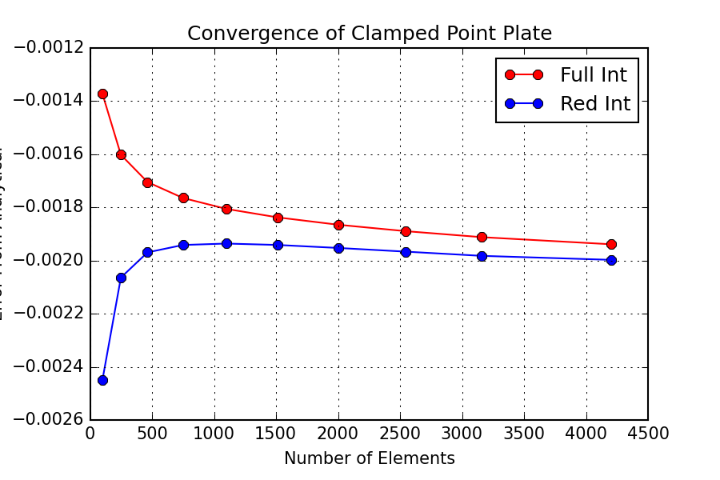
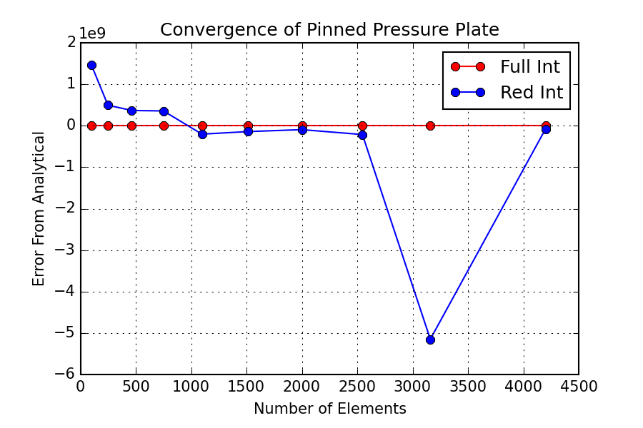
Error Analysis

Slide 9
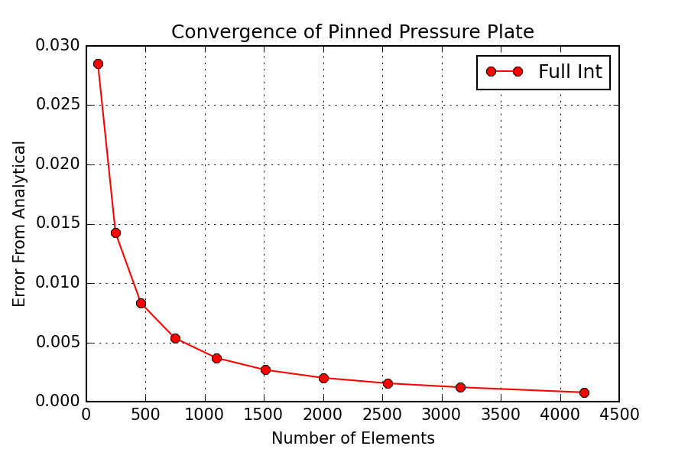
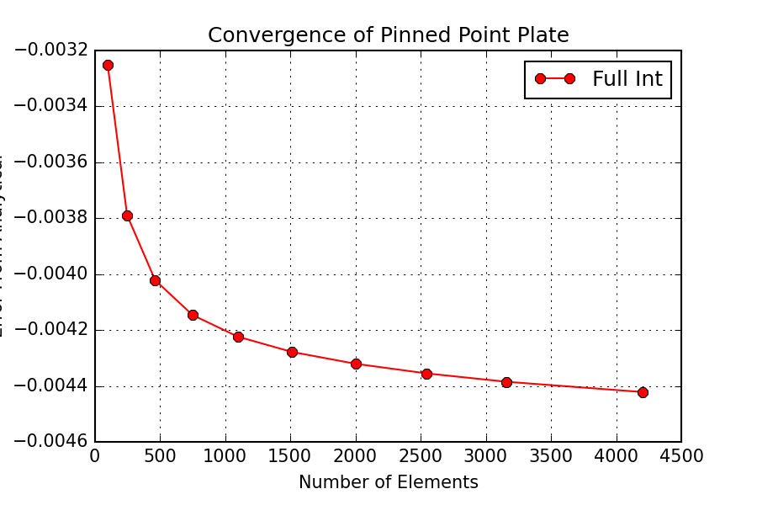
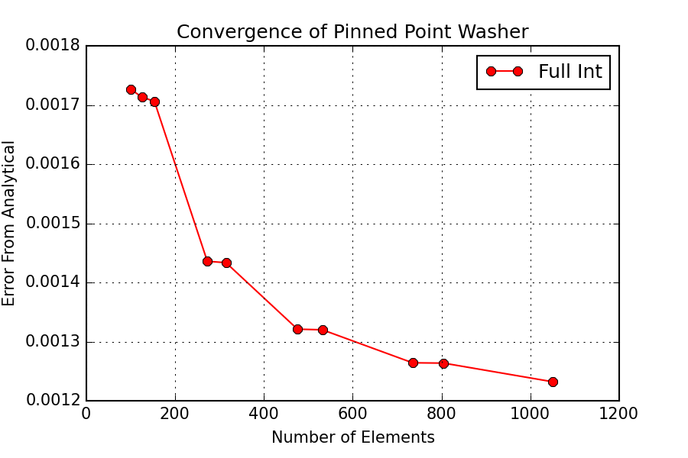
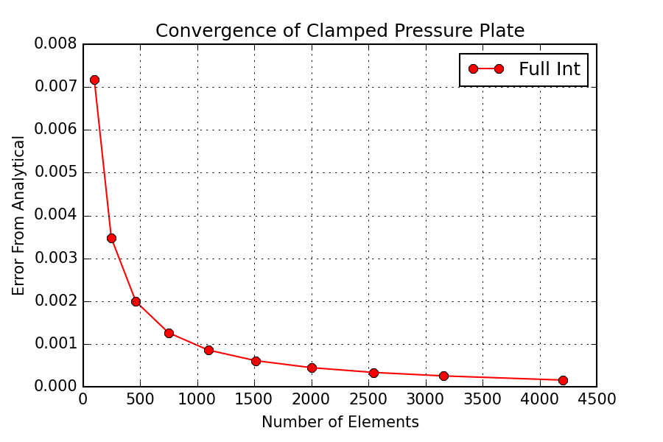
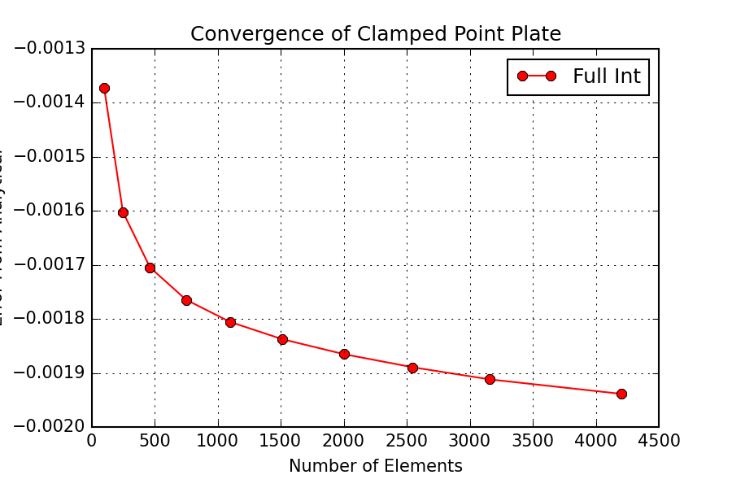
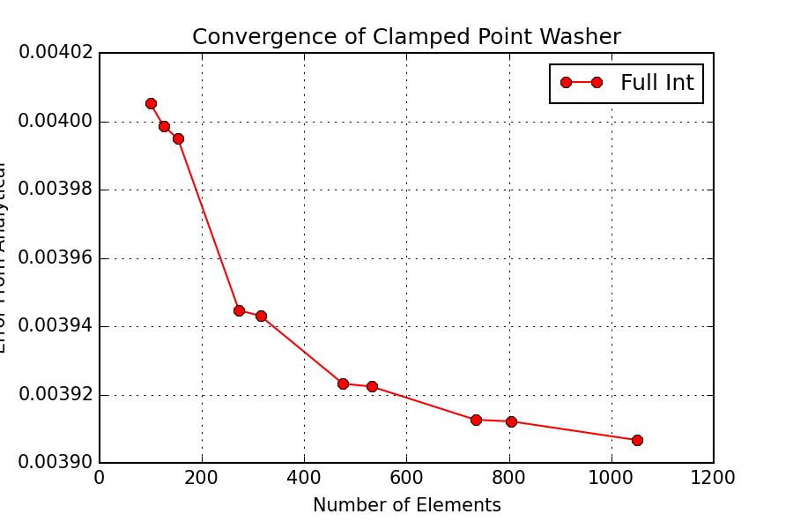
Error Analysis

